Slide 1
Mega Menus (1 of 3)
Home Fundamental Concepts User Experience Process Methods Training Resources
Overview
Playbooks Videos
Tools Newsletters
Personas FAQs
Case Studies Glossary
1
Site Map Contact Us: name@vha.gov 800-999-9999 Tell us how we’re doing! Provide Feedback Here Provide new content for UX Guide: Participate Now

Slide 2
What is a Playbook?
A Playbook is a set of UX Methods described in the context of the UX Process that are specifically designed to help solve problems faced in medical centers throughout the VA.
Teams that use Playbooks are trained not just on the coding feature, but on process, principles and methods that work to make projects move at the <what’s Kas’ words… speed of operation?> and result in safe, effective, and efficient features.
How to use a Playbook?
Find the Playbook that fits the problem you are trying to solve or find the Playbook that matches your project.
Don’t forget when you have time constraints, ambiguous requirements, or other competing priorities, the Playbook can help you make decisions about what you can do; not what you can’t do in order to get the biggest impact from the UX Method(s) you decide to use.
How to get started?
Find the Playbook that fits your project….
Creating a Clinical Reminder Dialog Template
Creating Order Sets
Improving the Efficiency of a Clinical Workflow

Slide 3
Creating a Clinical Reminder Dialog Template
This Playbook will help you apply a Human Centered Design Process as you create a Clinical Reminder Dialog Template.
As part of organizing your project, review the Process and associated Methods. Use the Guidance at each phase of the process to help determine where your time and effort is best spent based on your own project goals, time lines and competing priorities.
Let’s get started!
Back
Next

Slide 4
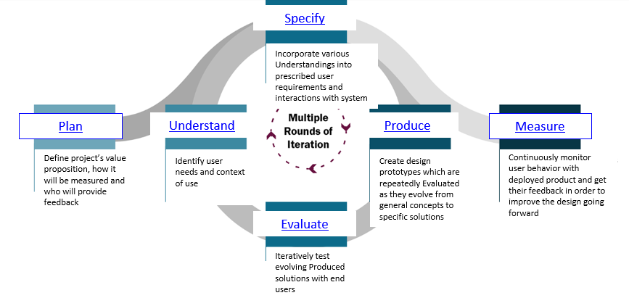
Adhering to a Process
It is important to adhere to a process! If your desired outcome is a safe, usable, effective, and/or efficient Clinical Reminder Dialog Template, then you must organize your project with a process that aims to achieve any one of these desired outcomes.
The UX process is illustrated below. It is a basis for including human-computer design activities. As a Clinical Reminder Dialog Template is defined, designed, and developed, certain phases of the UX process should be carried out — sometimes several times in a project life cycle.
Some phases can be repeated, as the result of iterative refinement of the solution. Phases are performed whenever certain outcomes are needed, and the degree of rigor when performing each phase can vary based on risk, context, and overall requirements.
Back
Next
Let’s see what methods you can use to achieve your project’s goal(s).

Slide 5
What’s important for your project?
Charting the activities based on your current knowledge e.g., Clear Requirements/Ambiguous Requirements, Prioritized Users/Users = everyone, CAC’s domain knowledge/lack of knowledge, Availability of clinician SME, Time, known/unknown potential barriers
Is aligning business goals and user needs key to the success of your project?
Consider Interviewing Key Stakeholders and Writing your Problem Statement.
Don’t have a clear understanding of the user, the user needs, and/or how the work environment? Are you having to rely on work as imagined and don’t have the understanding of how the work is actually done?
Consider observing the Intended User as s/he documents this information in their work environment and interview a clinician about their current documentation.
For each phase of the process, describe the question being addressed in the step framed in a manner that speaks to the intended Playbook user (i.e., CAC for this playbook)
Consider ….give the activity that will address the question and link to that associated page in the playbook
Back
Next

Slide 6
Plan
Identify quality objectives for usability and communicate with relevant project stakeholders. Define Process outcomes, and identify the activities and resources required for the project are identified. Define value propositions are defined.
Define the project’s value proposition, how it will be measured and who will provide feedback.
How to:
Identify Key Stakeholder(s)
Details to identify, invite, schedule, including time and variation
Links to tools, resources, templates, etc.
Interview Key Stakeholder(s)
Details to prepare, conduct, document, analyze, apply learnings, including time and variation
Links to tools, resources, templates, etc.
Write a Problem Statement and achieve key stakeholder consensus
Details to prepare, write, present, including time and variation
Links to tools, resources, templates, etc.
How to decide which, if any, of the activities listed above to do
Benefits and Trade-Offs for Including:
Draw from: Method and associated content
Draw from: Method and associated content
Draw from: Value Statement + Metrics, the Customer Grid, and Usability Specifications
Customer Grid – outlining the goals and measures for the template
Mapping Business Goal t the Key Quality measures
Usability Specification Table
Back
Next

Slide 7
Understand
Understanding the characteristics of the actual or intended user groups, including their tasks and goals, is key. In addition, the operational environment of the system, including the factors that affect the performance of the users, is described in sufficient detail to support the design activities.
Identify user needs and context of use.
How To:
Observation
Details to identify, invite, schedule, including time and variation
Links to tools, resources, templates, etc.
Interview a Clinical User
Details to identify, invite, schedule, including time and variation
Links to tools, resources, templates, etc.
How to decide which, if any, of the activities listed above to do
Benefits and Trade-Offs for Including:
Back
Next

Slide 8
Specify
Building on the value proposition from the Plan phase and user goals defined in the Understand phase, the Specify phase is where user requirements are precisely stated. These include the interaction requirements for users to achieve their intended outcomes, including the necessary information, choices, and inputs.
Incorporate various understandings into prescribed user requirements and interactions with system
Methods:
Write out each step of the clinical work flow and think about what is the user doing at each step
Catch the problems before you get too far…. the principles in the Heuristic Evaluation
Catch the problems before you get too far…. Kas’ Template Pattern Library
How to decide which, if any, of the activities listed above to do
Benefits and Trade-Offs for Including:
Draw from: Method (Task Analysis) and associated content
Draw from: Method (Heuristic) and associated content
Draw from: Method (Visual Modeling) and associated content
Back
Next

Slide 9
Produce
In the Produce phase, the user-system interaction is designed to address the high-level human-centered quality objectives. This phase includes the creation of an interface design solution that implements one or more user’s requirements that support tasks defined in the context of use description. The design will evolve from insights in the abstract into potential solutions, while iterating on prototypes and narrowing down the solution options.
Create design prototypes which are repeatedly evaluated as they evolve from general concepts to specific solutions
Methods:
Sketch before you code
Be inspired by others who’ve done this
How to decide which, if any, of the activities listed above to do
Benefits and Trade-Offs for Including:
Visual Modeling - point to CPRS-VistA Pattern Library
Literature Consultation
Back
Next

Slide 10
Evaluate
The evolving solution for user-system interaction is tested on end users during the Evaluate phase to determine if the design meets the user requirements and the initial value proposition. The team defines the relevant user profiles and tasks, as well as the context of use, for the portion of the solution that is being evaluated. The Evaluate phase is repeated on the evolving design solutions until the defined value proposition is achieved. User feedback is used to improve the solution throughout the development life cycle, particularly with respect to the results of earlier phases in the UX process.
Iteratively test evolving produced solutions with end users
Methods:
Catch the problems before you get too far…. the principles in the Heuristic Evaluation
Are you making an improvement… count the clicks ….Keystroke Level Modeling (KLM)
Usability Test – Formative
How to decide which, if any, of the activities listed above to do
Benefits and Trade-Offs for Including:
Heuristic Evaluation
Usability Test – Formative (time constraints may not lend for this point to guerrilla formative)
Keystroke Level Modeling (KLM)
Back
Next

Slide 11
Measure
When the solution meets the initial value propositions, the product is made available for use to the intended VA audience and the Measure phase continues to evaluate whether the desired value is being achieved in the users’ dynamic natural environments. As context of use and other external factors change, the design is continuously tested to determine if the value proposition is still being achieved and to inform future versions of the product.
Continuously monitor user behavior with deployed product and get their feedback in order to improve the deign going forward
Methods:
How did you do? Are there more improvements that can be gained?
How to decide which, if any, of the activities listed above to do
Benefits and Trade-Offs for Including:
User Survey – Questionnaire – Point to example from nursing where they had link to provide feedback
Back
Next

Slide 13
What’s important for your project?
Charting the activities based on your current knowledge e.g., Clear Requirements/Ambiguous Requirements, Prioritized Users/Users = everyone, CAC’s domain knowledge/lack of knowledge, Availability of clinician SME, Time, known/unknown potential barriers
Applied Cognitive Task Analysis
Visual Modeling – point to CPRS-VistA Pattern Library
Problem Statement (Writing)
Interviewing Key Stakeholder
How to ID the stakeholders
Interview-User
Observation
Visual Modeling - point to CPRS-VistA Pattern Library
Literature Consultation
User Survey – Questionnaire – Point to example from nursing where they had link to provide feedback
Heuristic Evaluation
Usability Test – Formative (time constraints may not lend for this point to guerrilla formative)
Keystroke Level Modeling (KLM)

